Slide 1
Failure To Deliver (FTD)
Project by: Therin Watson & Monil Shah
Date: October 6th

Slide 2

WHAT IS FAILURE TO DELIVER (FTD)?
“FAIL TO DELIVER” IS A SITUATION IN THE STOCK MARKET IN WHICH A BROKER/DEALER THAT HAS SOLD SECURITIES FAILS TO DELIVER THEM TO THE PURCHASING BROKER/DEALER BY THE TRANSACTION’S SETTLEMENT DATE.
STOCK MARKET TRANSACTIONS, FOR EXAMPLE, MOST SECURITIES ARE SETTLED ON A “T+3” BASIS, WHICH MEANS THAT THE BROKER/DEALER ON THE SELL SIDE MUST DELIVER THE SHARES TO THE BUY-SIDE BROKER/DEALER ON THE THIRD BUSINESS DAY FOLLOWING THE TRANSACTION DATE. A “FAIL TO DELIVER” OCCURS WHEN THE SELL-SIDE BROKER/DEALER DOES NOT DELIVER THE SECURITIES AS OF THAT DATE.
Notes:
Such failures occur when a buyer (the party with a long position) doesn't have enough money to take delivery and pay for the transaction at settlement.
A failure can also occur when the seller (the party with a short position) does not own all or any of the underlying assets required at settlement, and so cannot make the delivery.

Slide 3
Our objective
Attempt to correlate daily
quantity of FTDs posted to:
-Volume
-Closing price
-Daily change
To find out if there is any
actual correlation between
FTD Data and price movement
compared to so-called “meme”
stocks with volatile & less
volatile stocks
MEME STOCK CHOICES
GME (GameStop)
AMC (AMC Entertainment)
BB (BlackBerry)
NOK(Nokia Corporation)
VOLATILE STOCK CHOICES
TSLA (Tesla)
SHOP(Shopify)
QSR(Restaurant Brands Int.)
SPCE (Virgin Galactic)
LESS VOLATILE CHOICES
APPL(Apple)
MSFT(Microsoft)
GS(Goldman Sachs)
BRK(Berkshire Hathaway)

Slide 4
DATA Gathering
Three Data Sources:
SEC Website - FTD data
IEX Api - for stock chart information, primarily for close price and volume
Yahoo Finance API - for general stock ticker info, primarily the Outstanding Share and Current Float stats

Slide 5
DATA: Cleanup & Exploration
Challenge with clean up -
SEC Data:
Issues with symbols matching to similar but wrong symbols (for example, GME to GMED)
So instead changed search parameters to CUSIP number so we had a guaranteed unique identifier to find the data we were looking for

Slide 6
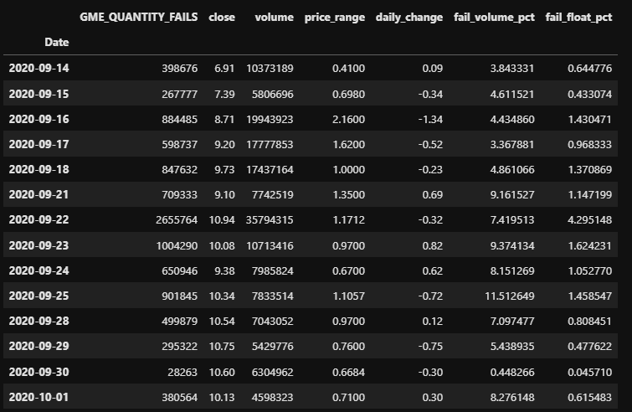
DataFrame Data After Parsing SEC Files and IEX and Yahoo APIs

Slide 7

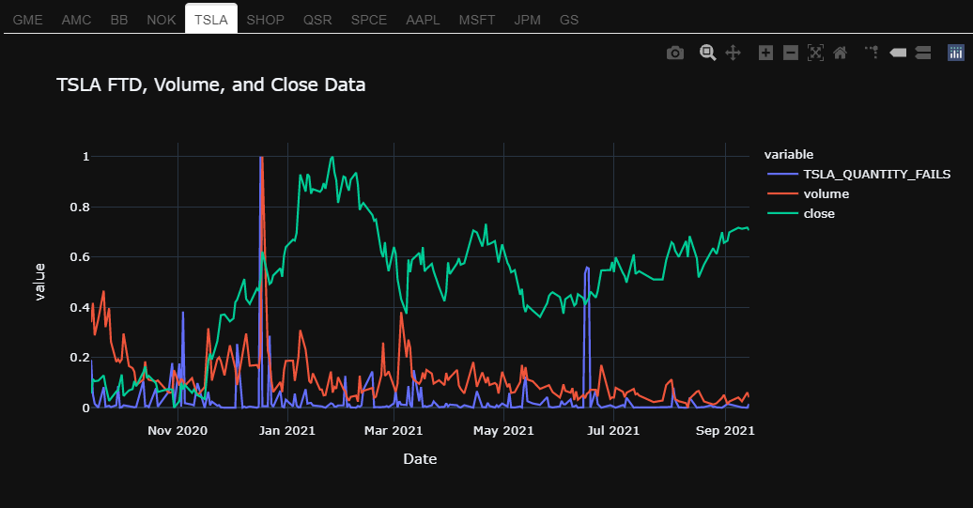

Slide 8
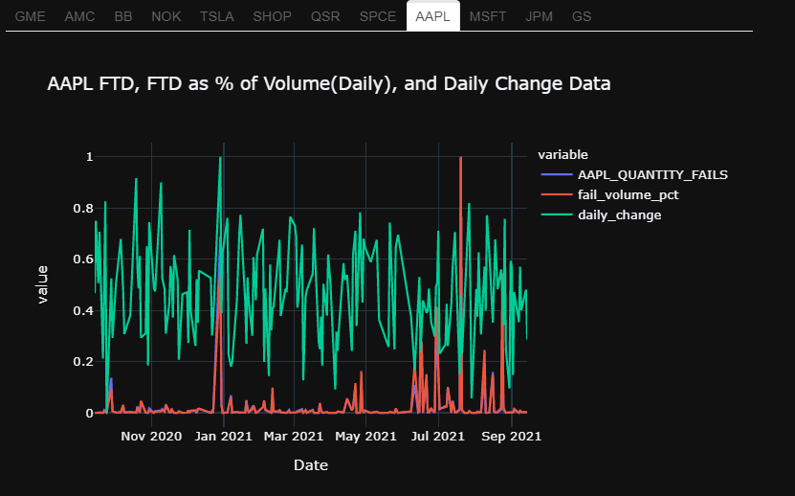

Slide 9
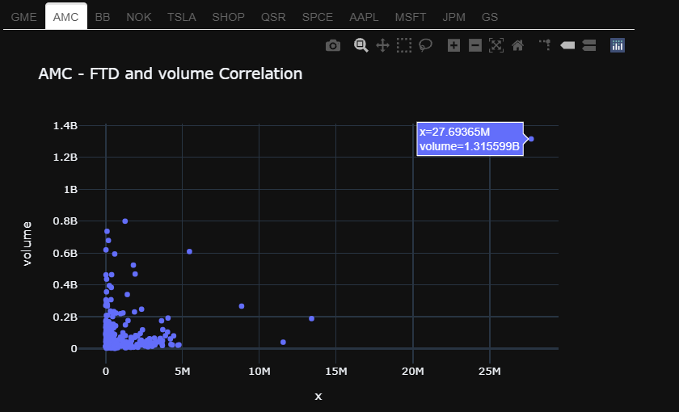

Slide 10
Data Exploration & Analysis
No meaningful correlation or relationship between FTDs, Volume, Closing price or Daily Price was found
Many interesting outliers(January 2021 in general, Tesla’s Volume~FDT) and individual data points
Within the same 12 stock pics GME, AMC & SPCE only stocks >1% FTDs of their floats for past year
Looked from different perspective - Any stocks that posted relevant(>1%) quantities of FTDs, relative to their float, in the past year of trading to find the outliers
With changing perspective and instead of hand picking, imported SEC data file containing all tickers (12000 tickers after cleanup) on the market (including ETFs)
Found IEX stopped posting float data in their data files in Dec. 2020

Slide 11
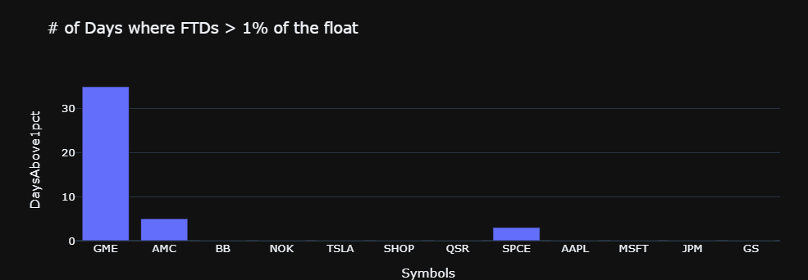
GME = 37 Days, AMC = 5 Days, and SPCE = 3 Days

Slide 12
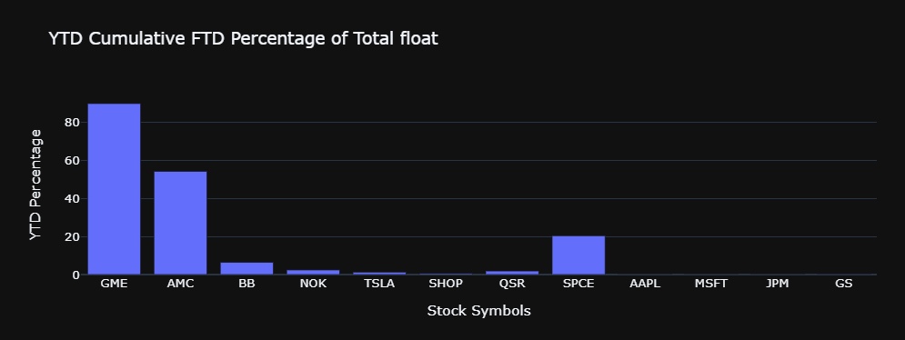
While GME and AMC were no surprise, SPCE appearing so high was quite the surprise.
Tesla posting such low numbers was a surprise as well.

Slide 13

Data Analysis
New questions and criteria
Instead of looking for data by using stock symbols and getting the numbers by searching the stock…
Now that we have criteria, what about finding a list of stocks that meets the criteria we are looking for?
Need to find a way to search for stocks on the market that post high amounts of fail-to-delivers relative to their float and/or outstanding shares, to find other outliers like GME, AMC, and SPCE from our above data
How do you search the market for data? You would probably need a list of stock tickers to do so
Luckily, the SEC files on FTDs include entries of over 12,000 unique equities and ETFs

Slide 14
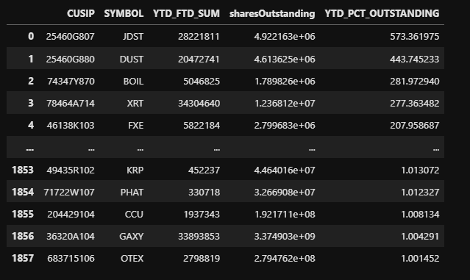
Search Criteria:
Calculate the cumulative total of FTDs reported per stock, by iterating through the SEC files and adding up all FTDs reported for the past year
If the sum of FTDs was greater than 1% of the outstanding shares of a company - keep the data and add it to a dataframe
1857 Total Results found

Slide 15
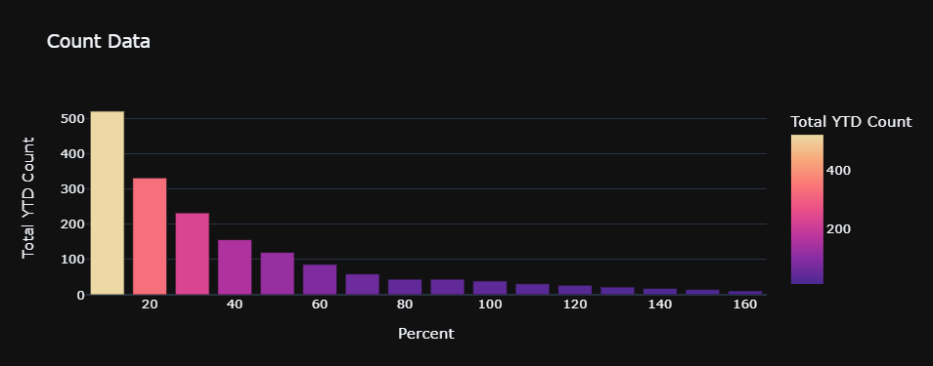
520 symbols posted FTDs greater than 10% of their Outstanding Shares
11 symbols posted FTDs greater than 160% of their Outstanding Shares

Slide 16
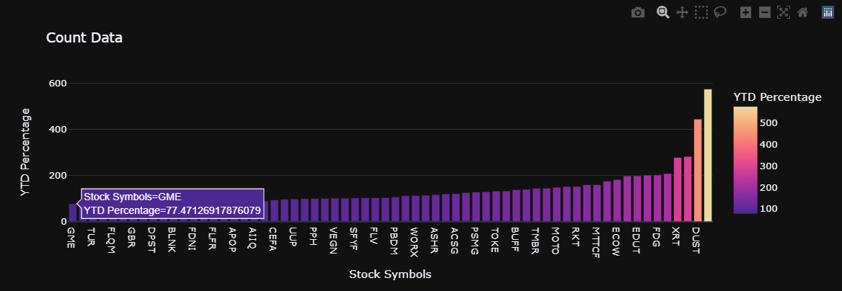
63 stocks and ETFs on the market posted FTDs at rates higher than GME, relative to their outstanding shares

Slide 17
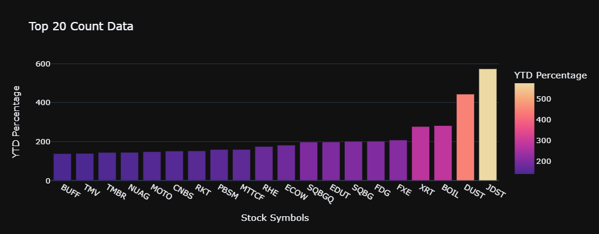
List of Top 20 Failing-to-Deliver stocks on the market

Slide 18
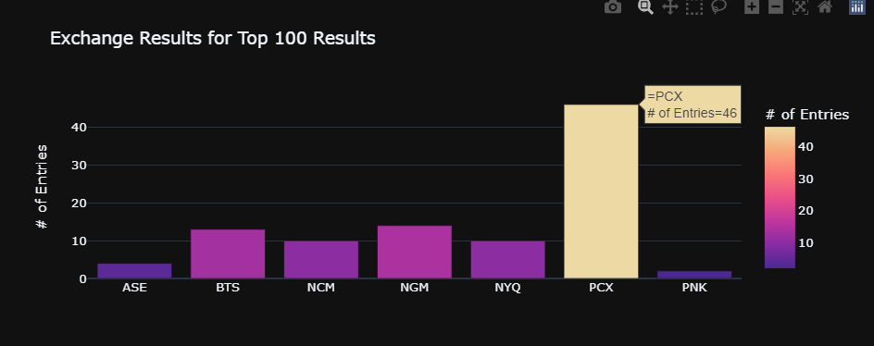
The PCX (Pacific Exchange) is an extreme outlier as the exchange with most Symbols of the Top 100 results

Slide 19
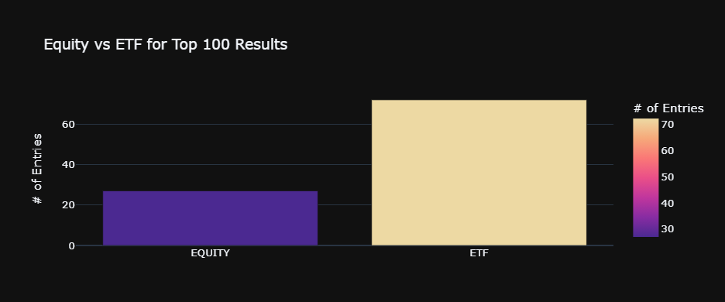
Of the Top 100 Failing-to-Deliver Symbols on the Market:
Equity = 27 ETF = 73

Slide 20
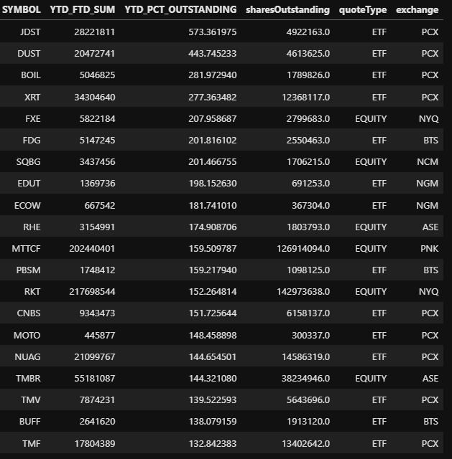
Implications
Fail to Delivers (FTDs) on the Market occur at freakishly high rates for some stocks compared to others
ETFs comprise the majority of symbols which post the absolute highest quanties of Fail to Delivers, relative to their Outstanding Shares
Most stocks on the market barely fail to deliver to the point of being negligible
When stocks do start to significantly Fail to Deliver, they Fail to Deliver A LOT

Slide 21
Conclusions
JDST is “Direxion Daily Junior Gold Miners Idx”, a gold miner ETF that has posted FTDs at almost 6x the quantity of shares it ever issued as an ETF
Either something is wrong with the data, or PCX seems to have a problem with Failing to Deliver
While Gamestop is the most popular and talked about stock on the market when it comes to FTDs, there’s definitely other equities which beat it
Still inconclusive on whether there is a relationship between a stocks price and its quantity of FTDs
More research is needed

